Slide 1
Category review: Chips
December 2022
Retail Analytics

Slide 2
Notes:
To view Privacy video explaining how important data privacy is to Quantium, please click here: https://www.youtube.com/watch?v=Zq1QDAkoRzU
or here Q:\Company Reference\Brand & Design\Brand videos\Q Privacy.mp4
At Quantium, we believe that data is the behavioural footprint of humanity and that it has to be treated with the utmost care and responsibility.
Histories, attitudes, indeed lives are stored within it in ways that aren’t always apparent – and that’s what makes its potential so powerful.
To work with it responsibly, sensitively, we set ourselves the highest data privacy protection and governance standards.
We have spent 17 years perfecting privacy-by-design and secure-by-design principles. Central to this is not holding any personally identifiable information about people –
we neither receive it, and put the necessary protections in place to be unable to decipher it.
Every aspect of handling data is safeguarded: from its de-identification, to its encryption – data security is paramount and of the highest grade.
We pride ourselves on gaining the trust of iconic organisations around the world through years of securely working with their data,
and in turn the trust that builds with their stakeholders.

Slide 3
Executive summary
The month of December has shown maximum sales because of Christmas and New Year.
People prefer buying chips on Sunday, Wednesday and Friday.
New Families and Mid-age Singles/Couples are the only category of Life stage where we observed low sales.
Mainstream and Budget Customers are driving maximum sales for us.
People prefer buying 2 packets most of the time.
Packet Size – 175g is the most preferred by People.
01
Task 1
02
Task 2
The Total Sales Revenue is 1712562.1.
The Total Number of Customers are 70367.
Average Transaction per customer is approximately 3.33 ~ 3.
The results for trial stores 77 and 88 during the trial period show a significant difference in at least two of the three trial months but this is not the case for trial store 86. We can check with the client if the implementation of the trial was different in trial store 86 but overall, the trial shows a significant increase in sales.

Slide 4
01
Customer Analytics

Slide 5
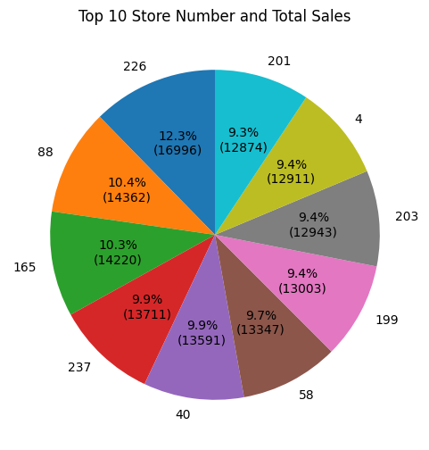
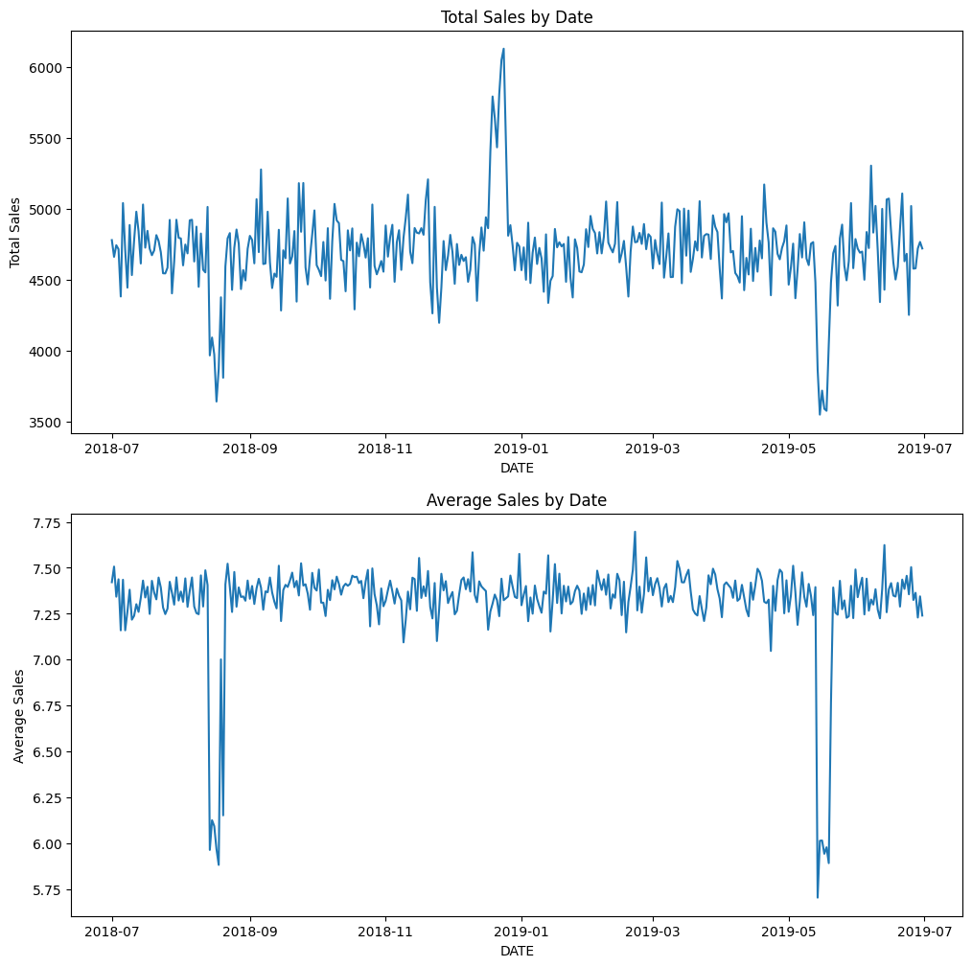
Store Performance: Total and Average Sales by Date:

Slide 6
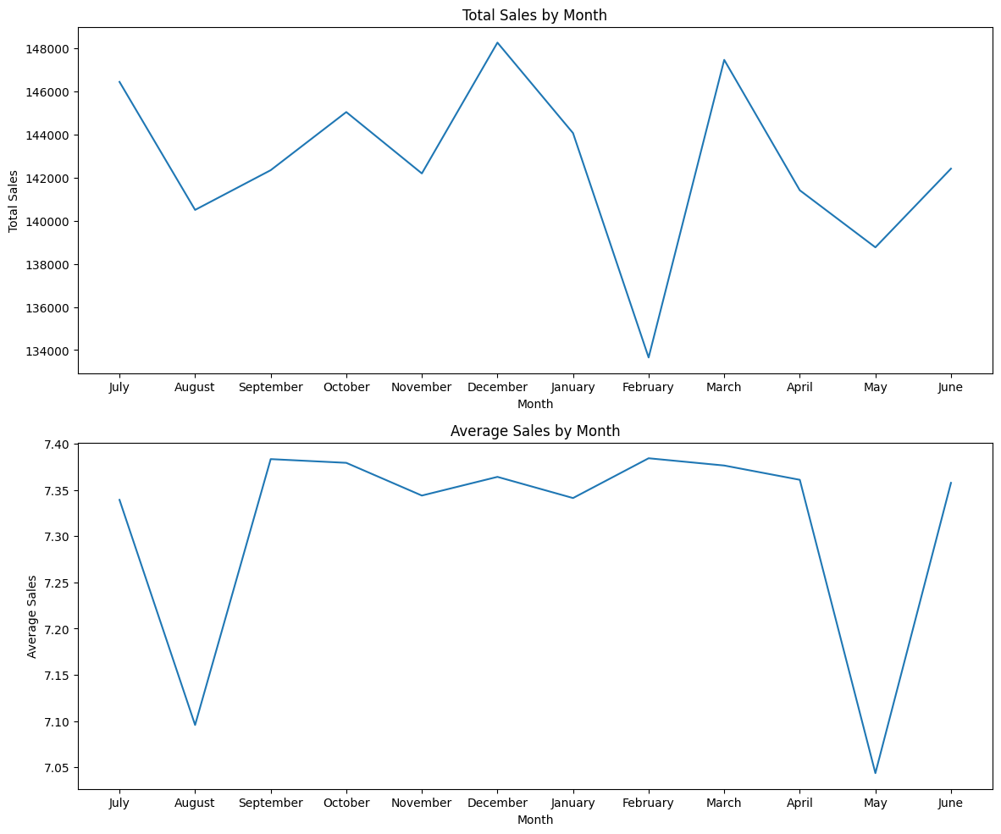
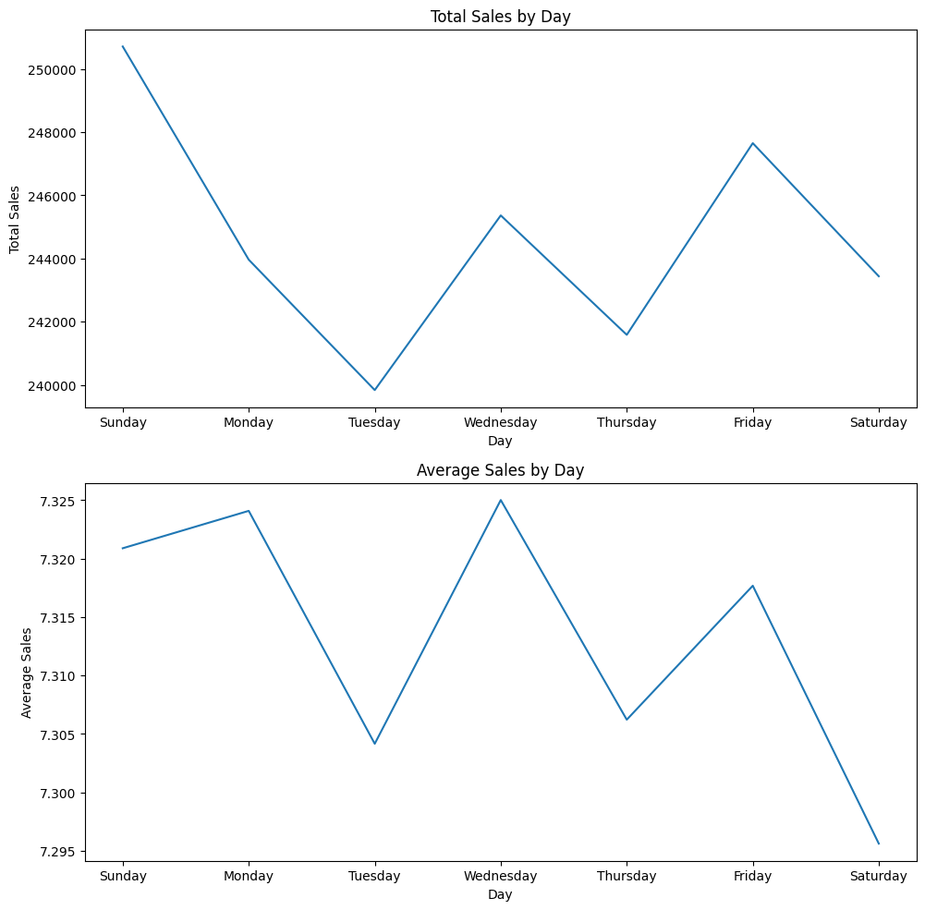
Total and Average Sales by Month and Day:

Slide 7
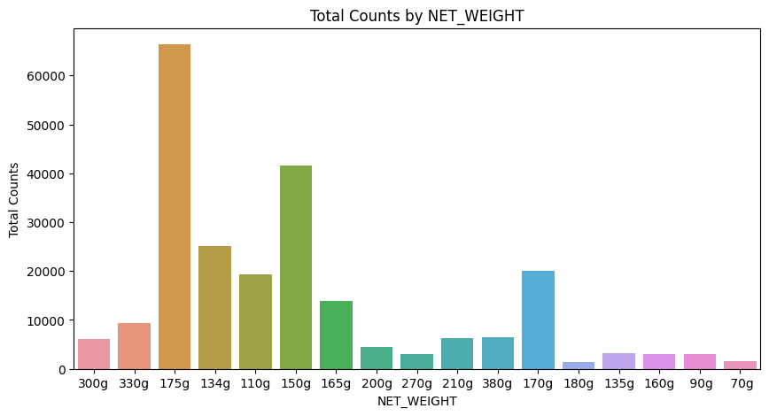
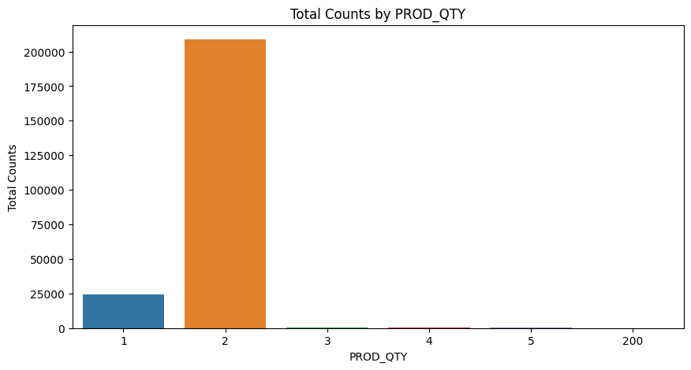
Category of Chips preferred by Customer:

Slide 8
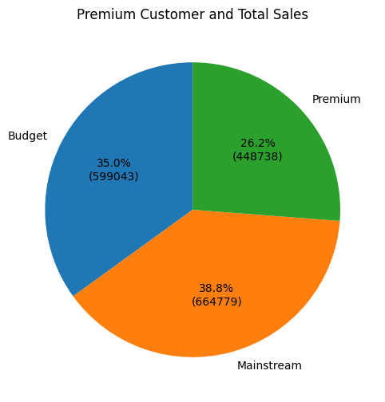
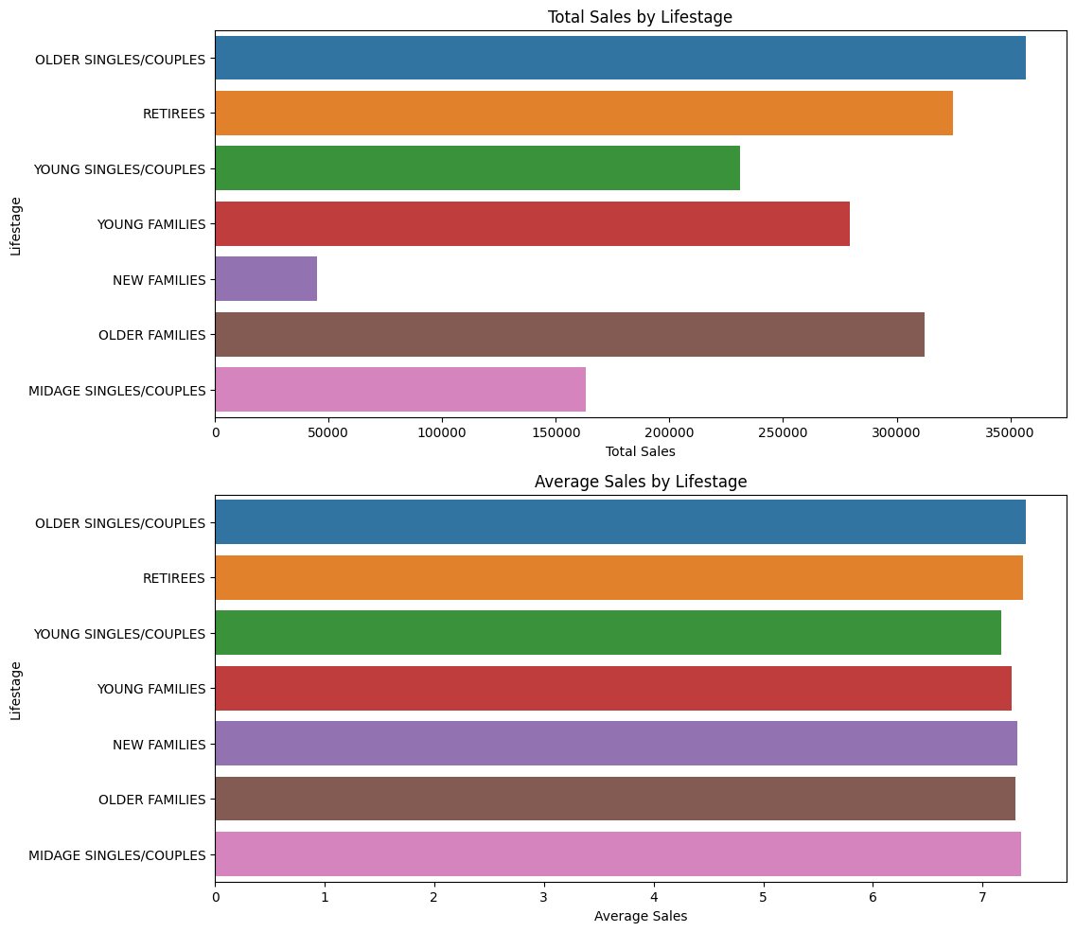
Customer Type and Life-stage Analysis:

Slide 9
02
Trial store performance

Slide 10
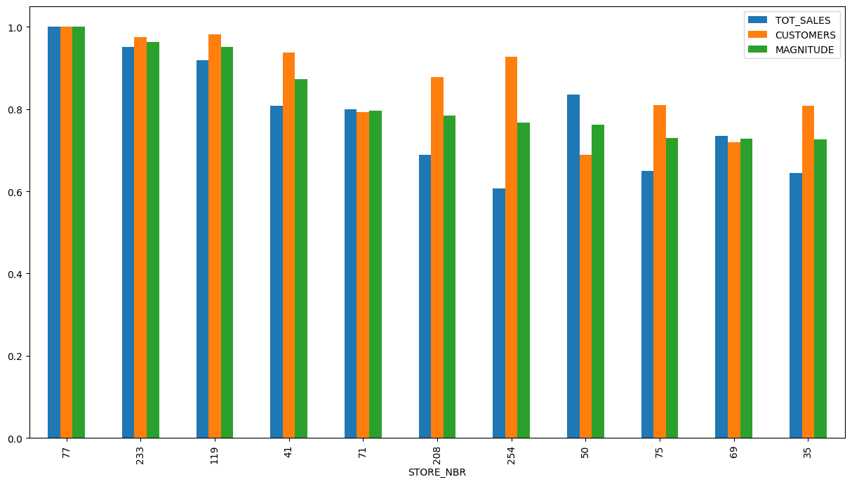
Control Store 77 vs Other Stores:

Slide 11
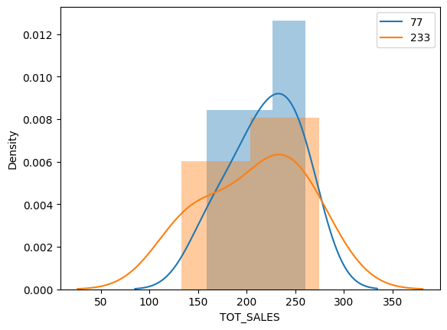
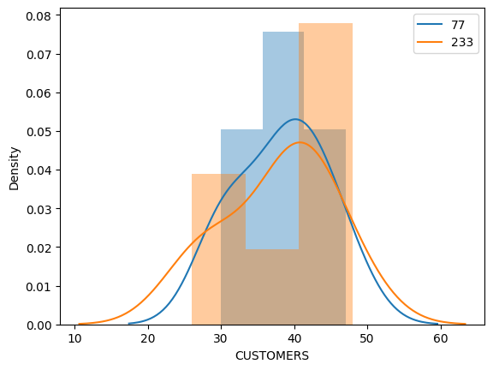
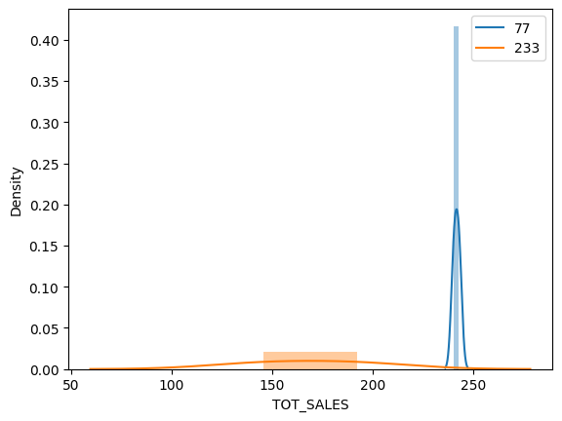
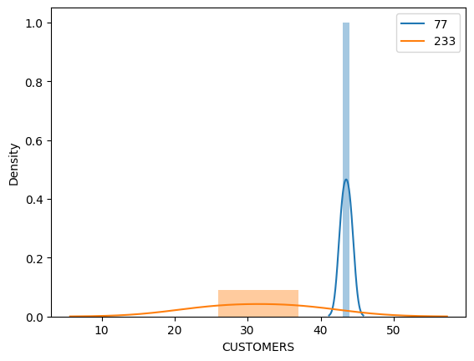
Trial Store Performance:

Slide 12
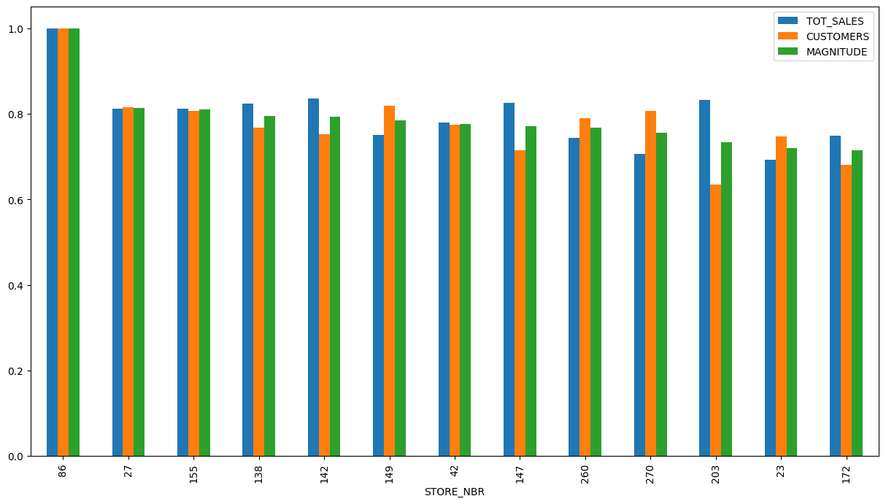
Control Store 86 vs Other Stores:

Slide 13
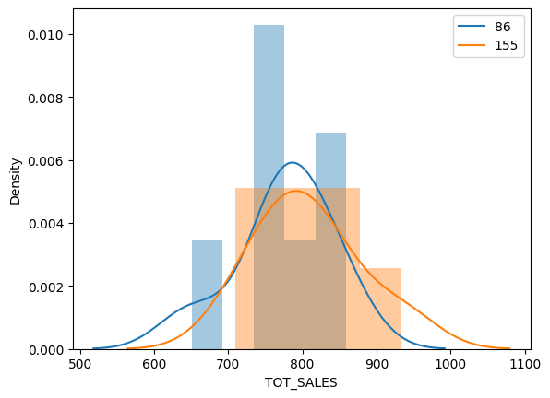
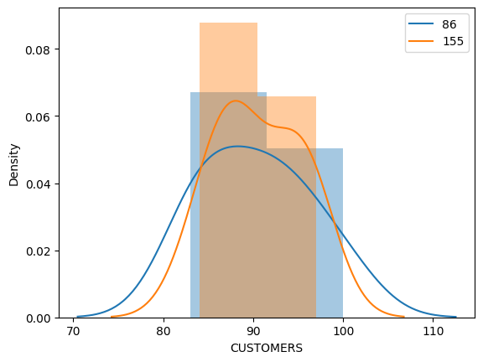
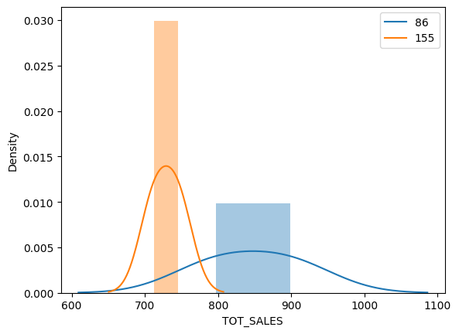
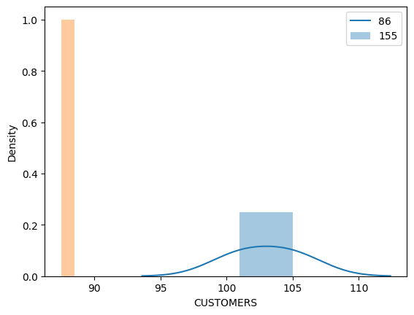
Trial Store Performance:

Slide 14
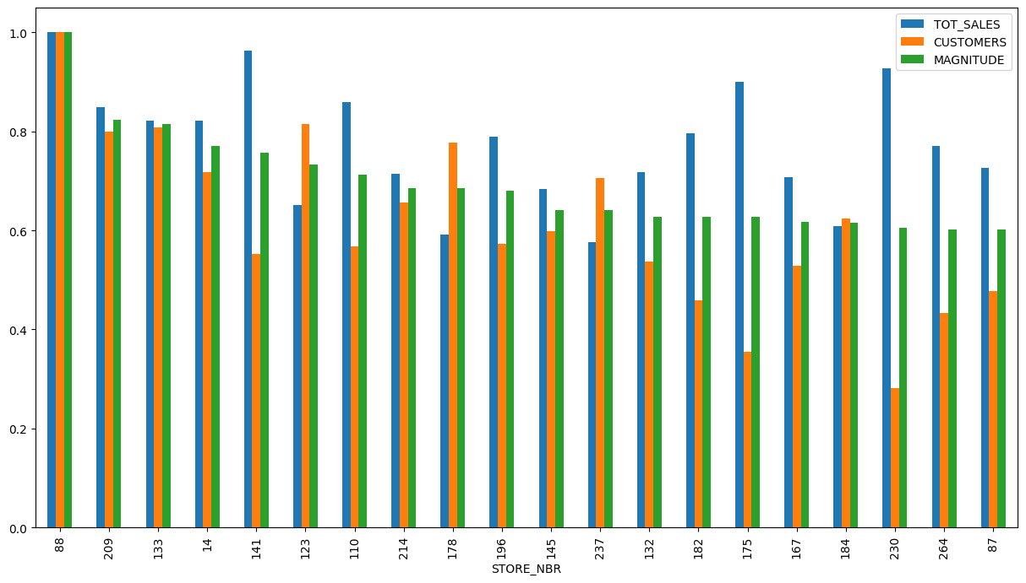
Control Store 88 vs Other Stores:

Slide 15
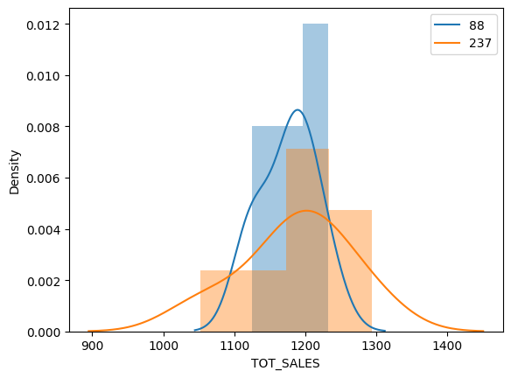
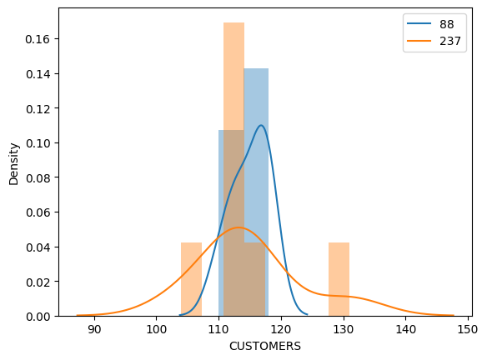
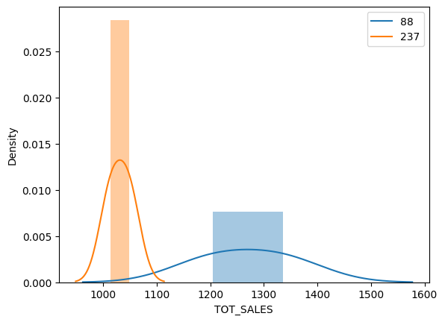
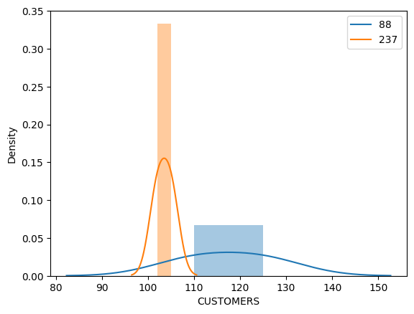
Trial Store Performance:

Slide 16
Conclusion
We've found control stores 233, 155, 237 for trial stores 77, 86 and 88 respectively.
The results for trial stores 77 and 88 during the trial period show a significant difference in at least two of the three trial months but this is not the case for trial store 86.
We can check with the client if the implementation of the trial was different in trial store 86 but overall, the trial shows a significant increase in sales.
Recommendations
Stocks should be high in December before the Christmas
Mainstream young singles/couples, retirees are the account for a great share of chips sale so they need much attention.
Budget older families have the maximum contribution to sales.
Control stores 233, 155, 237 for trial stores 77, 86 and 88 respectively would be a good choice

